Slide 1
Modern Constraint Programming Education: Lessons for the Future

Slide 2

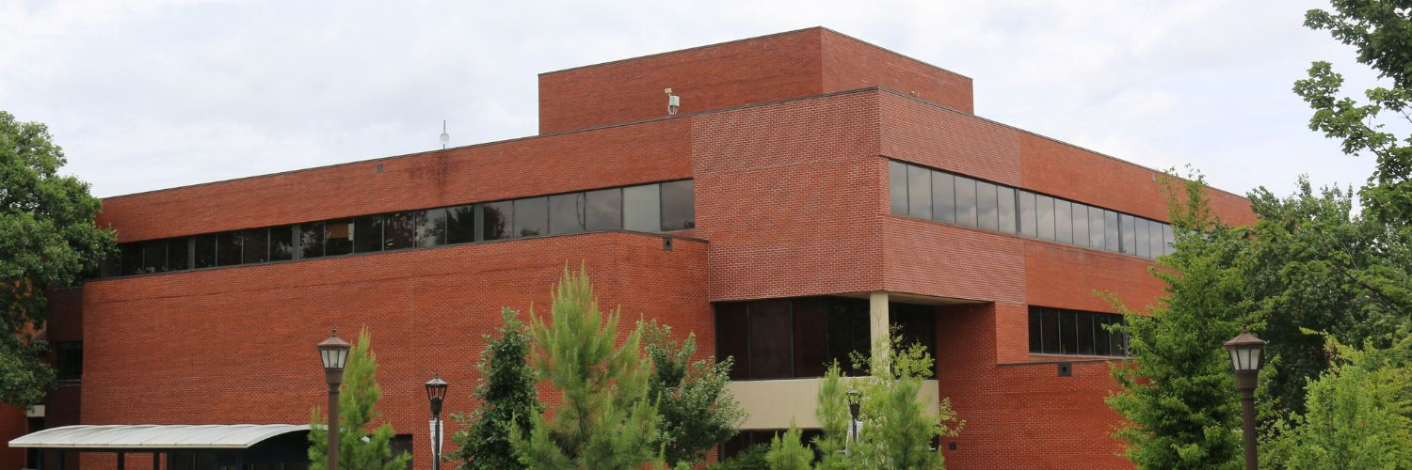
The Georgia Tech CP Course

Slide 3



The Georgia Tech CP Course

Slide 4
The Georgia Tech CP Course
Basics of CP
Elements of CP
Reification
Optimization
Global Constraints
Modeling in CP
Symmetry breaking
Redundant constraints
Search in CP
Scheduling
Interval vars
Sequence vars
Cumulative constraints
Advanced Topics
Routing
Scripting
CP in Python
MiniCP

Slide 5
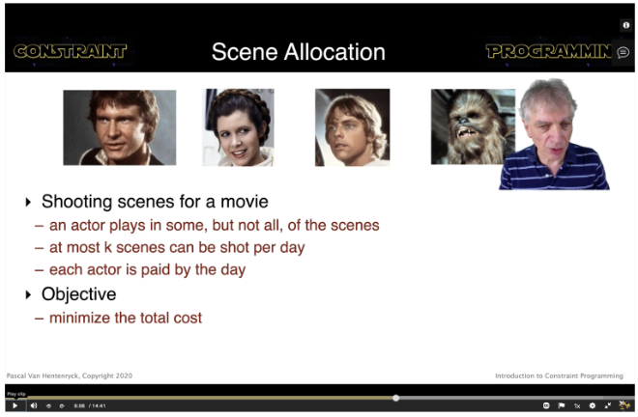
Lecture Videos

Slide 6

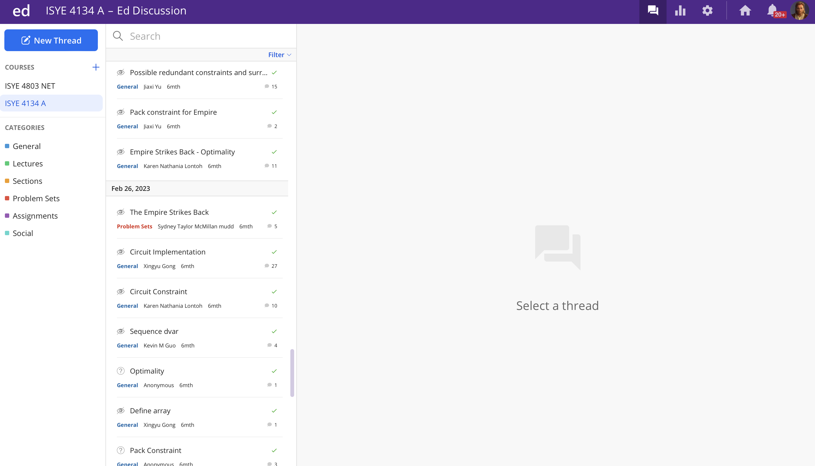
Interactive Sessions and Discussion Forums

Slide 7
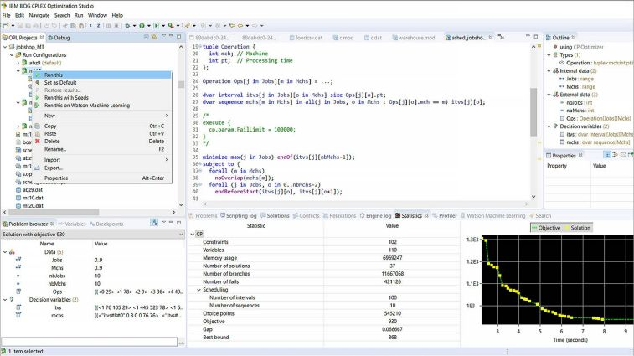
Assignments

Slide 8

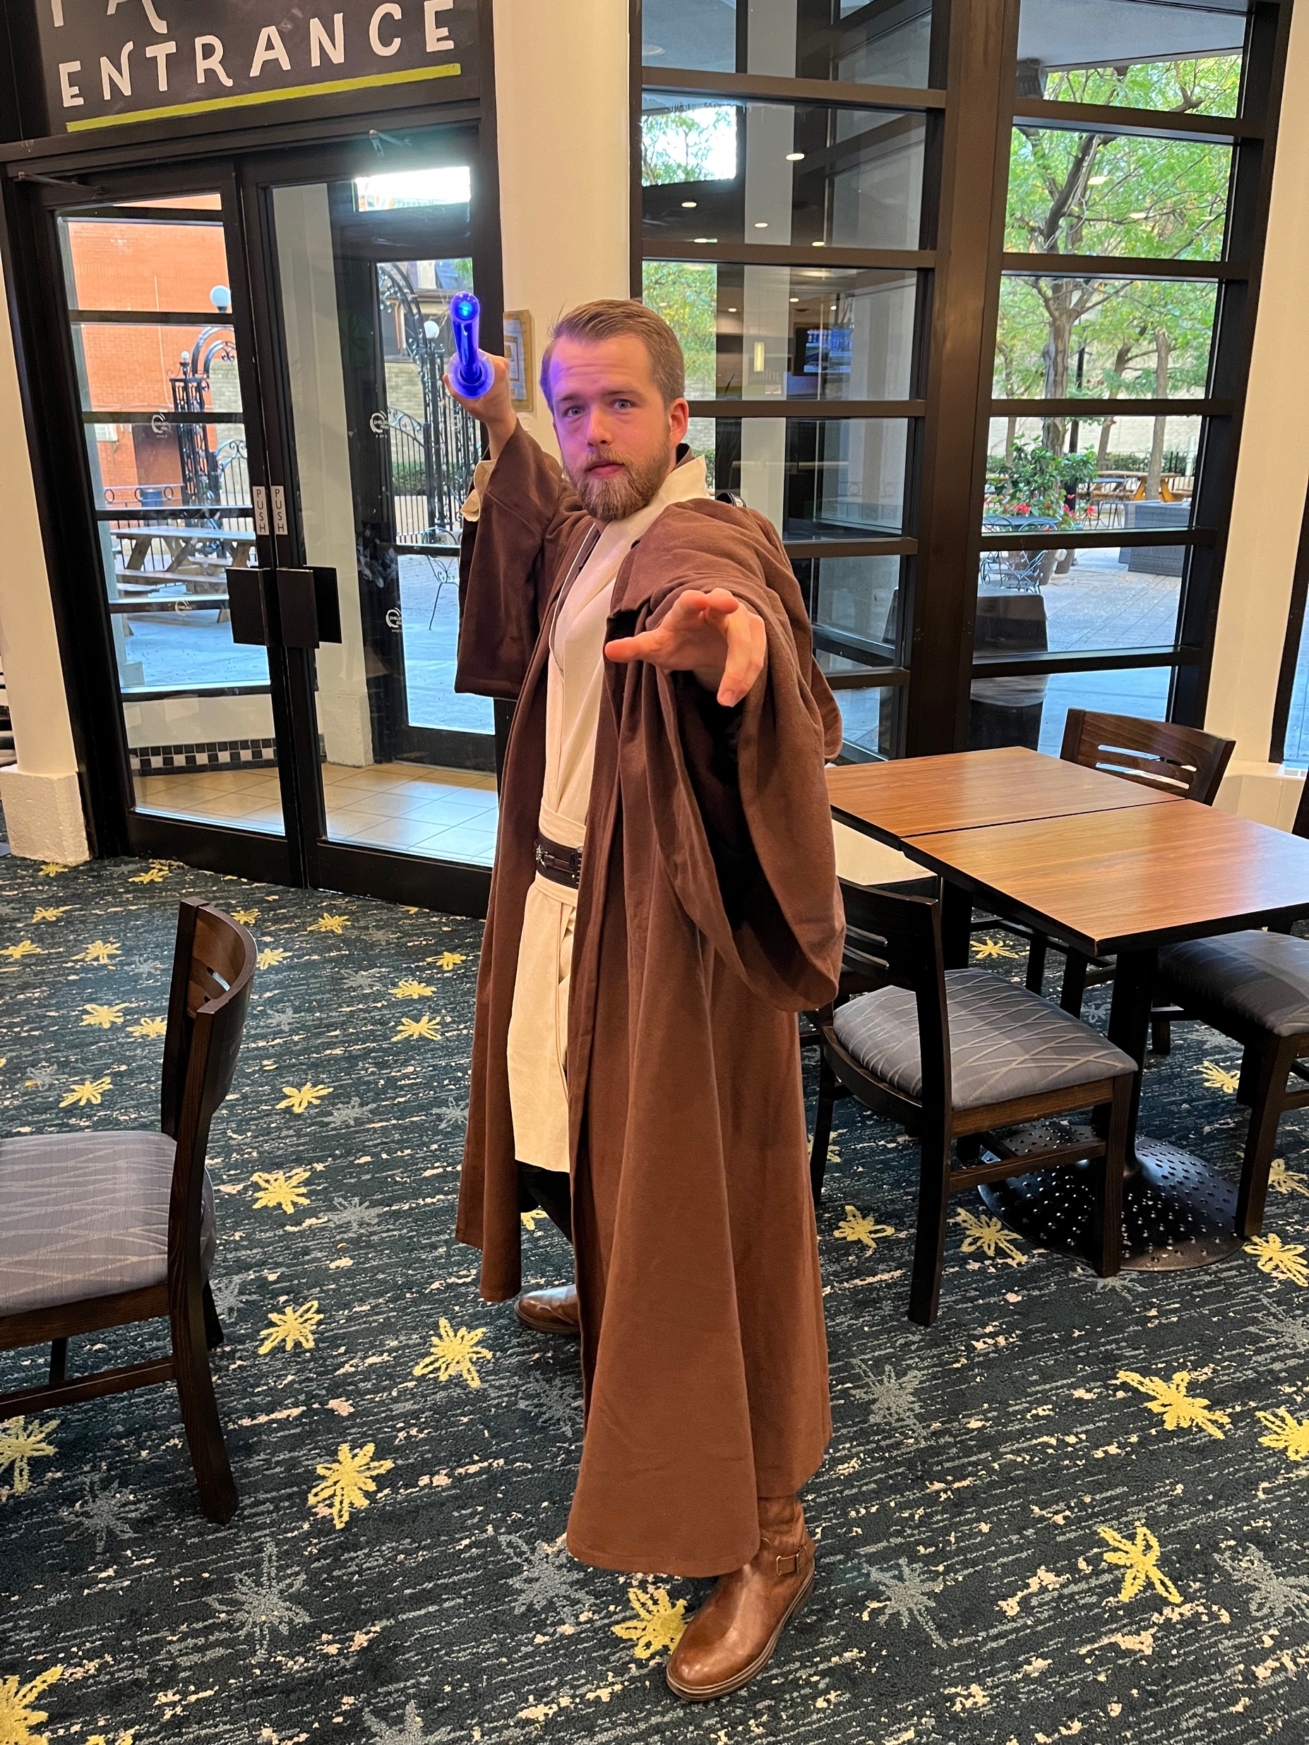
Star Wars Theme

Slide 9
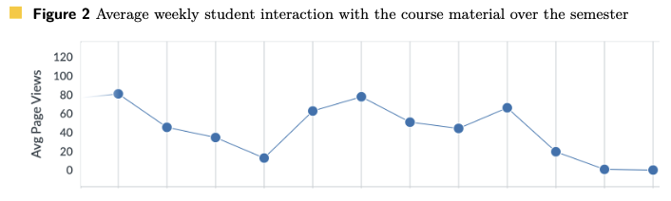
Student Engagement

Slide 10
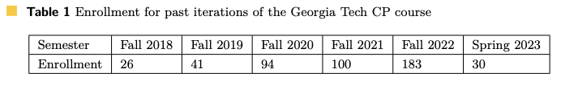

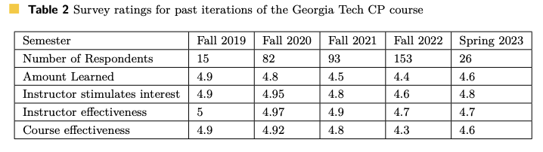
Student Reception

Slide 11

Teaching to Undergraduate and Engineering Students

Slide 12
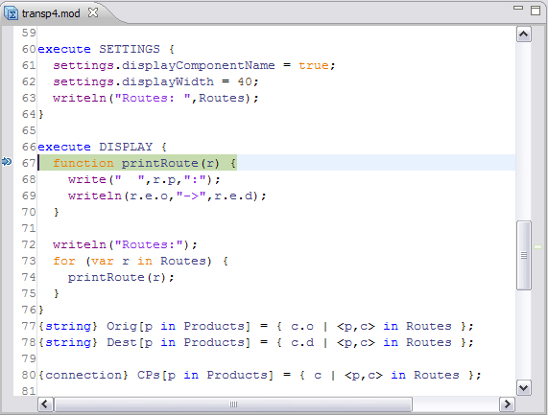
Modeling-Focused Teaching and Autograders

Slide 13

Distance Learning

Slide 14
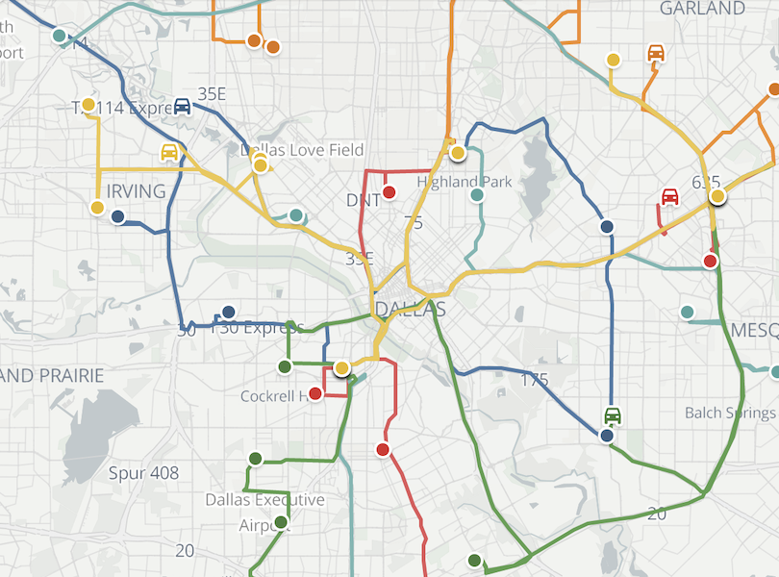

Promotion of CP

Slide 15
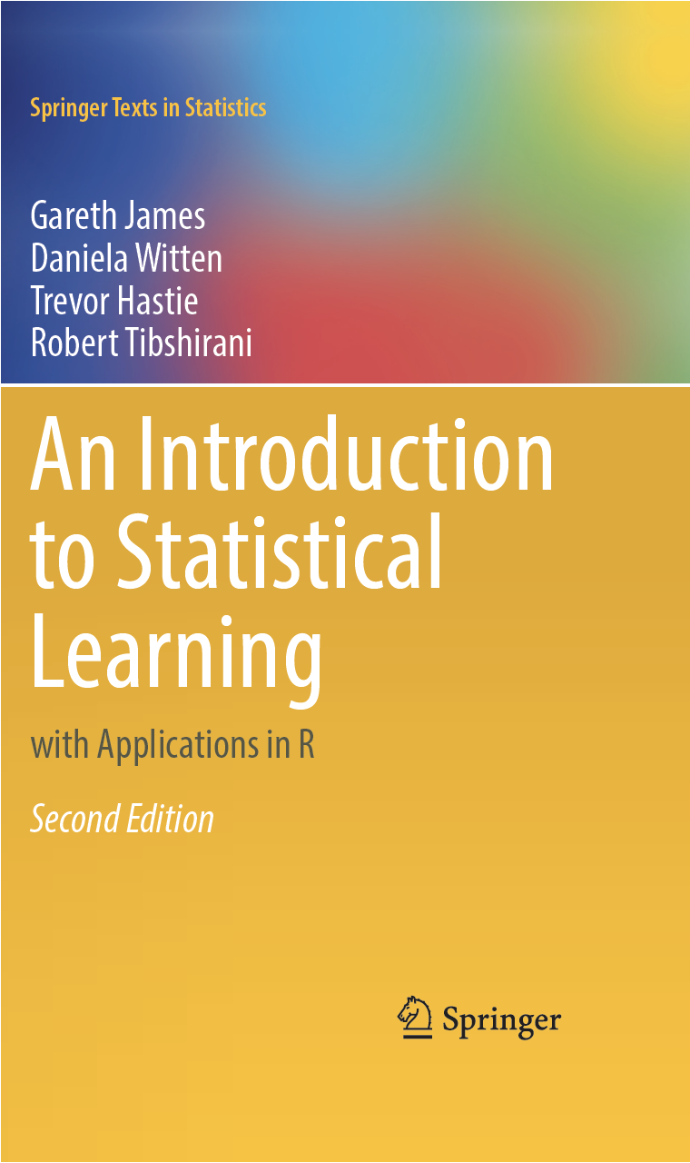

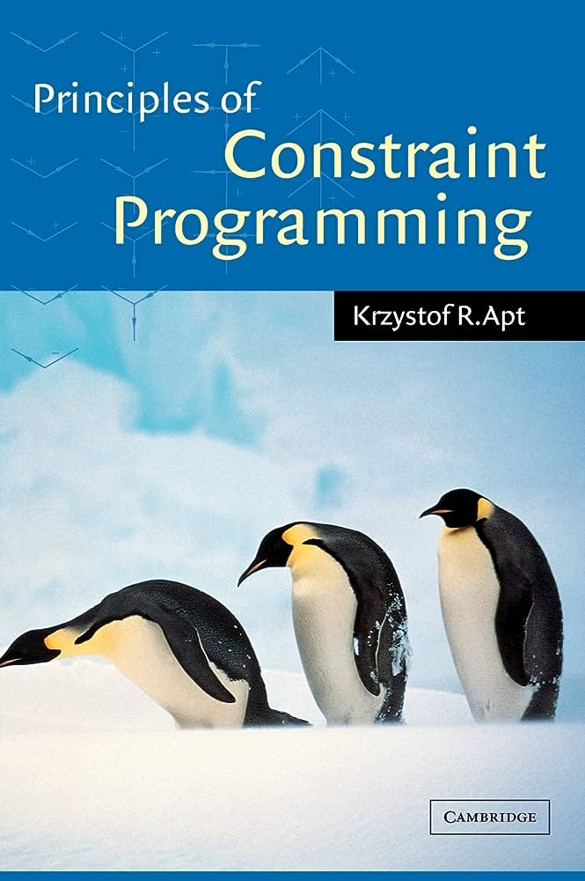


Introductory Resources and Availability

Slide 16
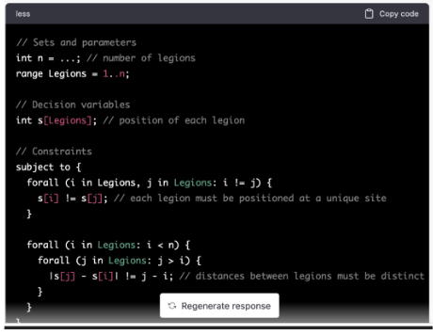
Impact of LLMs

Slide 17
Thank you!

